Slide 1
Vendor Data Management
04 May 2011
Notes:
Vendor Data Management - <number>
Guidewire training materials contain Guidewire proprietary information that is subject to confidentiality and non-disclosure agreements. You agree to use the information in this manual solely for the purpose of training to implement Guidewire software solutions. You also agree not to disclose the information in this manual to third parties or copy this manual without prior written consent from Guidewire. Guidewire training may be given only by Guidewire employees or certified Guidewire partners under the appropriate agreement with Guidewire.

Slide 2
Lesson objectives
By the end of this lesson, you should be able to:
  Understand and implement service provider performance reviews
  Understand proximity searches and geocoding
  This lesson uses the notes section for additional explanation and information.
  To view the notes in PowerPoint, choose View→Normal or View→Notes Page.
  If you choose to print the notes for the lesson, be sure to select “Print hidden slides.”
Notes:
Vendor Data Management - <number>

Slide 3
Lesson outline
Service provider performance reviews
Proximity search and geocoding
Notes:
Vendor Data Management - <number>

Slide 4
Service providers
A service provider is a ClaimCenter contact that:
  Provides a service during the resolution of a claim
  Is not related to the carrier
Examples:
  Repair shops
  Damage assessors
  Attorneys and law firms
  Medical clinics and caregivers
Notes:
Vendor Data Management - <number>

Slide 5
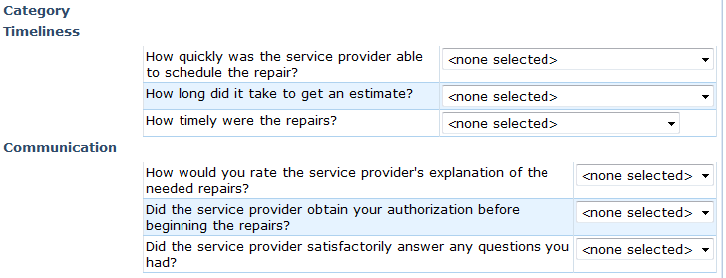
Service providers performance reviews
Review consists of sets of scorable questions about quality of services provided by vendor contacts
Enables search based on vendor rating
Improves customer satisfaction with rendered services
Improves speed of claim resolution
Notes:
The service provider performance review feature is only available if ClaimCenter is integrated with ContactManager.
Vendor Data Management - <number>

Slide 6
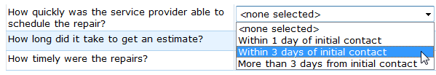
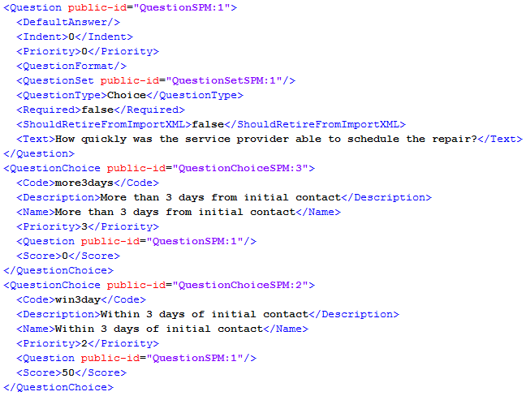
Questions and scores
Notes:
This slide shows the QuestionSPM:1 question in the sample Auto Repair Service performance review. The question is displayed as "How quickly was the service provider able to schedule the repair?" The third question choice is for more than three days from initial contact, and it is associated with a score of zero. The second question choice is for within three days from initial contact, and it is associated with a score of 50. The third question choice—not visible in the screenshot—is for within one day from initial contact, and it is associated with a score of 100.
Vendor Data Management - <number>

Slide 7
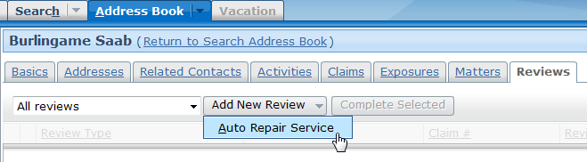
Creating a review
In ClaimCenter click "Reviews" tab
Click Add New Review and select review type
Notes:
Vendor Data Management - <number>

Slide 8
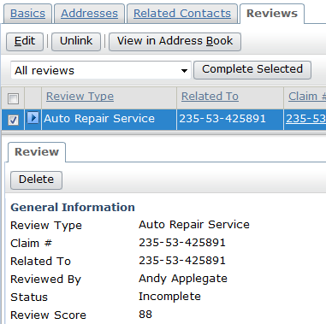
Creating a review (cont)
Select values for each question
Click Update
Select review, then click Complete Selected
Notes:
Reviews are not processed by the system until their status is Complete. Incomplete reviews can be edited, but complete reviews cannot be.
Vendor Data Management - <number>

Slide 9
ContactManager processes reviews and scores
ClaimCenter stores review with associated claim
Synchronization process sends completed reviews to ContactManager
ContactManager averages review with scores of all existing reviews and saves result with service provider's contact information
Review processing can be triggered manually or scheduled
Notes:
Vendor Data Management - <number>

Slide 10
Steps to manually process reviews
Log in to ClaimCenter as administrator
Press ALT + SHIFT + T to access Server Tools
Click Run for ClaimCenter (SPM) Completed Review Sync process
Log in to ContactManager as administrator
Press ALT + SHIFT + T to access Server Tools
Click Batch Process Info
Click Run for AB Contact Score Aggregator process
Notes:
Manually processing reviews is useful when testing the performance review configuration.
Guidewire Contacts and ContactManager - <number>

Slide 11
Steps to schedule automatic processing of reviews
Configure the ReviewSync process
Configure the ABContactScoring process
Notes:
A work queue is a batch process that distributes a processing-intensive load across multiple servers.
In ClaimCenter, the ReviewSync writer collects reviews that have been completed but not sent to ContactManager yet and creates work items for them. The ReviewSync worker then processes each review prepared by the writer and sends them to ContactManager.
In ContactManager, the ABContactScoring writer collects the contacts that need to be updated and creates work items for them. The ABContactScoring worker then processes each queued work item and updates the scores for the contacts.
Guidewire Contacts and ContactManager - <number>

Slide 12
Step 1: Configure the ReviewSync process
In ClaimCenter Studio, expand Other Resources
Click scheduler-config.xml to edit
Remove the <!-- --> comment markers enclosing the ReviewSync entry
<ProcessSchedule process="ReviewSync">
<CronSchedule minutes="20"/>
</ProcessSchedule>
Save and close the resource
Notes:
The default configuration shown here configures the process to execute 20 minutes after every hour.
Vendor Data Management - <number>

Slide 13
Step 2: Configure the ABContactScoring process
In ContactManager Studio, expand Other Resources
Click scheduler-config.xml to edit
Remove the <!-- --> comment markers enclosing the ReviewSync entry
<ProcessSchedule process="ABContactScoring">
<CronSchedule hours="0"/>
</ProcessSchedule>
Save and close the resource
Notes:
The default configuration shown here configures the process to execute at midnight every day.
Vendor Data Management - <number>

Slide 14
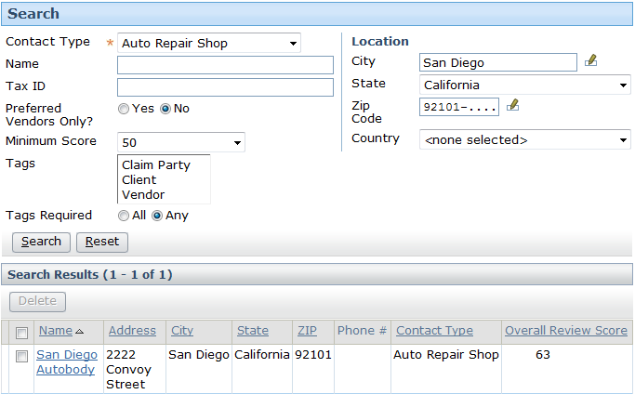
Searching based on minimum score
If there are performance review types for a contact type, can search for those contact types with a minimum score
Notes:
TrainingApp Business Functionality - <number>

Slide 15
Lesson outline
Service provider performance reviews
Proximity search and geocoding
Notes:
Vendor Data Management - <number>

Slide 16
Proximity searches
Distance-based search finds, for example, the closest 10 body shops within 20 miles of San Francisco
Order-based search finds, for example, the 10 closest addresses to the city San Mateo in California
Notes:
Guidewire Contacts and ContactManager - <number>

Slide 17
Steps to configuring geocoding
Configure the GeocodePlugin plugin in ClaimCenter
Configure the GeocodePlugin plugin in ContactManager
Configure ClaimCenter parameters
Configure ContactManager parameters
Configure ClaimCenter work queue
Configure ContactManager work queue
Restart servers
Notes:
Guidewire Contacts and ContactManager - <number>

Slide 18
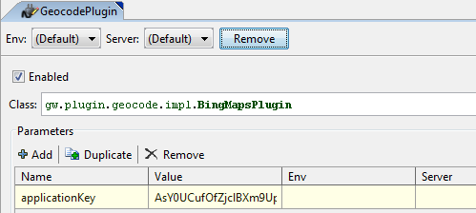
Step 1: Configure plugin in ClaimCenter
In ClaimCenter Studio, navigate to Plugins > gw > plugin > geocode > GeocodePlugin
Click Enabled
Enter your Bing Maps key in the Value cell for the applicationKey parameter
Notes:
Guidewire Contacts and ContactManager - <number>

Slide 19
Step 2: Configure plugin in ContactManager
Repeat process in ContactManager Studio
Notes:
Guidewire Contacts and ContactManager - <number>

Slide 20

Step 3: Configure ClaimCenter parameters
In ClaimCenter Studio, navigate to Other Resources
Click config.xml to open in editor
Set UseGeocodingInPrimaryApp and UseGeocodingInAddressBook to true
Notes:
Other parameters should be modified depending on the customer's requirements. Consult the documentation for detailed information about each parameter.
The following parameters must be set to the same values in the config.xml files for both ClaimCenter and ContactManager if the applications are integrated:
UseGeocodingInAddressBook
UseMetricDistancesByDefault
ProximitySearchOrdinalMaxDistance
Guidewire Contacts and ContactManager - <number>

Slide 21

Step 4: Configure ContactManager parameters
In ContactManager Studio, navigate to Other Resources
Click config.xml to open in editor
Set UseGeocodingInAddressBook to true
Notes:
Guidewire Contacts and ContactManager - <number>

Slide 22
Step 5: Configure ClaimCenter work queue
In ClaimCenter Studio, expand Other Resources
Click work-queue.xml to edit
Modify GeocodeWorkQueue queue
<work-queue workQueueClass="com.guidewire.pl.domain.geodata.geocode.GeocodeWorkQueue" progressinterval="600000">
<worker instances="1" batchsize="100"/>
</work-queue>
Save and close the resource
Notes:
The configuration shown here allots 10 minutes for the worker to process 100 geocode work items.
Vendor Data Management - <number>

Slide 23
Step 6: Configure ContactManager work queue
In ContactManager Studio, expand Other Resources
Click work-queue.xml to edit
Modify ABGeocodeWorkQueue queue
<work-queue progressinterval="600000" workQueueClass="com.guidewire.ab.domain.geodata.geocode.ABGeocodeWorkQueue">
<worker batchsize="100" instances="1"/>
</work-queue>
Save and close the resource
Notes:
Vendor Data Management - <number>

Slide 24
Restart servers
Stop ClaimCenter server
Stop ContactManager server
Start ContactManager server
Start ClaimCenter server
Notes:
Guidewire Contacts and ContactManager - <number>

Slide 25
Steps to manually process geocode items
Log in to ClaimCenter as administrator
Press ALT + SHIFT + T to access Server Tools
Click Run for Geocode Writer process
Log in to ContactManager as administrator
Press ALT + SHIFT + T to access Server Tools
Click Batch Process Info
Click Run for AB Geocode process
Notes:
Manually processing reviews is useful when testing the performance review configuration.
Guidewire Contacts and ContactManager - <number>

Slide 26
Lesson objectives review
You should now be able to:
  Understand the concept of vendor contacts
  Work with contacts in ClaimCenter
  Understand and implement service provider performance reviews
  Understand proximity searches and geocoding
Notes:
Vendor Data Management - <number>

Slide 27
Notices
Copyright © 2001-2011 Guidewire Software, Inc. All Rights Reserved.
Guidewire, Guidewire Software, Guidewire ClaimCenter, Guidewire PolicyCenter, Guidewire BillingCenter, Guidewire Reinsurance Management, Guidewire ContactManager, Guidewire Vendor Data Management, Guidewire Client Data Management, Guidewire InsuranceSuite, Guidewire ContactCenter, Guidewire Studio, Gosu, Deliver Insurance Your Way, and the Guidewire logo are trademarks or registered trademarks of Guidewire Software, Inc. in the United States and/or other countries.
This material is Guidewire proprietary and confidential. The contents of this material, including product architecture details and APIs, are considered confidential and are fully protected by customer licensing confidentiality agreements and signed Non-Disclosure Agreements (NDAs).
This file and the contents herein are the property of Guidewire Software, Inc. Use of this course material is restricted to students officially registered in this specific Guidewire-instructed course, or for other use expressly authorized by Guidewire. Replication or distribution of this course material in electronic, paper, or other format is prohibited without express permission from Guidewire.
    Guidewire products are protected by one or more of the following patents: U.S. Patent No. 7,885,831; U.S. Patent No. 7,788,296.
Notes:
Vendor Data Management - <number>

